Slide 1
IDE Setup & Basic Commands

Slide 2
IDE Setup
You should have:
R installed
Rstudio installed
Access to the internet

Slide 3
Is R easy to learn? It depends...
Computer Science
Programming skills
Data management
Statistics
Statistical skills
R is easy to learn (compared to other programming languages)
Statistical theory is hard
R is hard to learn (compared to common tools) but much more powerful.
Statistical theory is easy
R Users
Data science applications

Slide 4
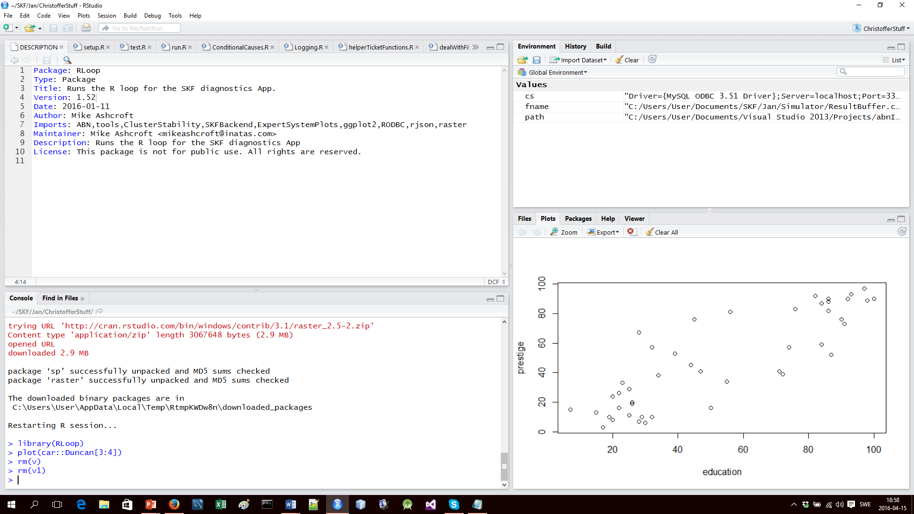
Environment
& History
Script Window
Files, Plots, Packages,
Help & Viewer
Console

Slide 5
IDE
Console
Where you type commands and receive text output.
Script Window
Script files are text files used to store scripts of R commands. Multiple can be open at once.
Source runs an entire file.
Run runs a highlighted selection.
Write multiline code, including functions, in a script file and then run them from there.
Environment & History
Environment – Display the objects (including functions) present in the environment.
History – Display commands previously entered into the console.
Files, Plots, Packages, Help & Viewer Window
Files – Navigate your computer’s file system. Double clicking a file will open it in the script window.
Plots – Basic graphic output. Export graphics using the export button.
Packages – Manage packages.
Help – Displays help information.
Viewer – Used to view local web content, web graphics and local web applications. We will not use it.

Slide 6


R Help
help, ?
specify function name:
?lm
help.search, ??
specify string
??"principle components"
Google and the internet are your friends!
Find packages that fit your needs
Find how to use packages and functions
Solve common bugs

Slide 7
R As Calculator
Assignment
=, <-
Arithmetic operators
+, -, *, /, ^
Logical Values & Operators
TRUE, FALSE
&&, &, ||, |, !, ==, !=, <, >, <=, >=
Some other simple arithmetic functions we will use
max, min

Slide 8
Vectors
Ordered collections of the same type of variables
numeric, string, logical
Access items/subvectors by [indices]
negative indices
vectors of indices (try ':' operator)
Join
c
Vectorized operations:
arithmetic & logical
compare &&,|| with &,|
Exercises: length, which, mean, sum, prod, sd,...
Generate 20 random integers between 1 and 10
What is the mean, sum, prod, sd
Which are greater than or equal to 5? Output indicies, output values.
Which are greater than 8 or less than 3? Output indicies, output values.

Slide 9
Matrices
2d ordered collections of single type of variable
Index using [row,column]
Empty indices: [row,], [,column]
cbind, rbind
nrow, ncol, length

Slide 10
Lists
Ordered collections of any type of variables
Can have named fields
Access items by $name or [[indices]]
Access sublists by [indices]
Join using c or append

Slide 11
Packages: Installing and loading
install.packages("package_name")
Links to CRAN, requires internet access
library(package_name)
Loads package into current environment
Do it:
install.packages("car")
library(car)

Slide 12
Data and data frames
data(Duncan)
head(Duncan)
summary(Duncan)
indices:
As list for columns, will return a data frame
As matrix for elements, columns and rows. Rows returns a data frame.
realValued=Duncan[-1]
Often used with formula (discuss later)

Slide 13
Importing data
If the data is stored as a text file, read.table, read.csv, read.csv2, read.delim and read.delim2 can be used.
Look at documentation for details about parsing the text
Many packages exist to interact with data storage systems and specific file types.
RODBC: all major SQL databases,
openexlsx: Microsoft Excel files
foreign package
Google it!

Slide 14
Functions in R
Treated as any other variable. Made with 'function':
mySubtractionFunction=function(a,b) {a-b}
Arguments specified by name or order
Default values
Implicit return, explicit via 'return'
Create and store functions in script files.

Slide 15
Control
if (condition) {code} else if (condition2) {code} else {code}
Tests conditions and executes code unit corresponding to the first true one
for (i in vector) {code}
We will only use for loops. Other types in R are while, repeat
break - breaks from loop (not used in this course)
next – skip to next iteration of the loop (not used in this course)
consider using apply functions instead

Slide 16
Apply Family
sapply
Apply function to each element in list or vector. Returns vector (matrix) of results.
lapply
Apply function to each element in list or vector. Returns list of results.
apply
Apply function to each row (1) or column (2) or element (3) in matrix or data frame.

Slide 17
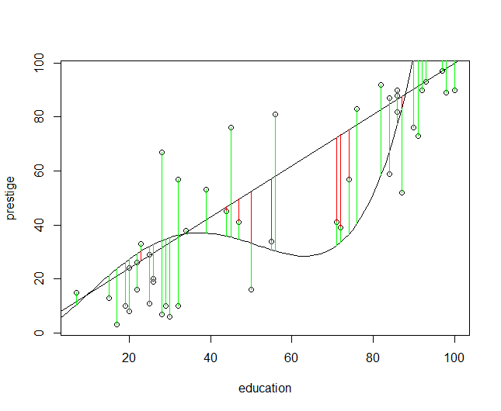
Basic Plotting
plot
points
segments

Slide 18
Plotting exercises
Plot education vs prestige in the car::Duncan data.
Create and plot a function that takes X as an argument, and returns 20-.75X+.15X^2.
Plot the distance of the plotted points to this line in red. Use segments.
Notes:
library(car)
data(Duncan)
plot(Duncan[3:4])
abline(5,.95)
segments(Duncan[,3],Duncan[,4],Duncan[,3],f1(Duncan[,3]),col="red")
f1=function(X) 5+.95*X
f2=function(X)2+X+.04*X^2-.0016*X^3+.000013*(X)^4
plot(f2,add=T,from=0,to=100,col="blue")
segments(Duncan[,3],Duncan[,4],Duncan[,3],f2(Duncan[,3]),col="green")

Slide 19
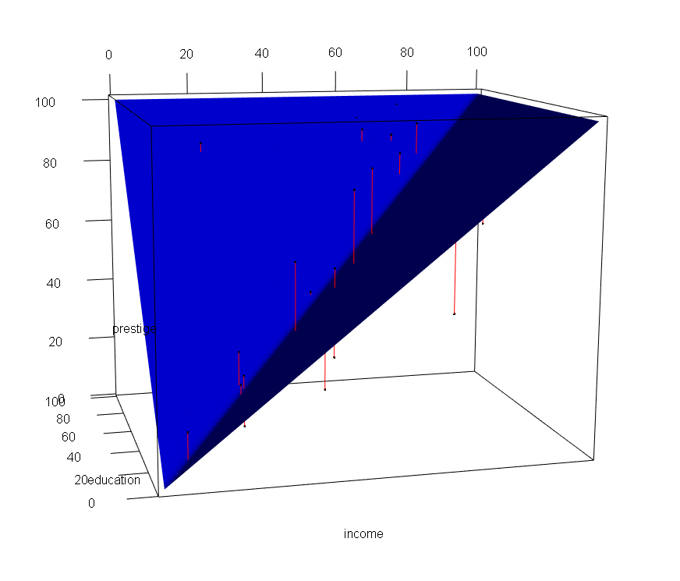
Basic 3d Plotting
rgl package
plot3d
surface3d
segments3d

Slide 20
3d plotting exercises
Plot prestige vs income + education from the Duncan data
Create a function of two vectors that returns the maximum element for each index from both
use cbind, apply and max
Plot a blue surface where z = max(x,y) using your function
use the outer function to create the grid
use surface3d to plot the surface
Plot residuals in red using segments3d
Notes:
library(car)
data(Duncan)
library(rgl)
f3=function(A,B)apply(cbind(A,B),1,function(row)max(row))
grid=outer(1:100,1:100,f3)
surface3d(1:100,1:100,grid,col="blue")
for (i in 1:nrow(Duncan)) {
segments3d(
rbind(
c(Duncan[i,2:4]),
c(Duncan[i,2:3],f3(Duncan[i,2],Duncan[i,3]))
), col="red")
}

